Slide 1
Scalable Multimodel Deep Esemble Learning Framework for Mob Behavior Analysis
Previous 6 Month Report

Slide 2
Overview
Manual Supervision Challenges
Monitoring mob activity from surveillance cameras requires continuous human presence.
Multiple cameras increase the chance of missing critical events.
Need for Automated Analysis
Lack of timely information leads to delayed law enforcement response.
Early detection of mob buildup allows for effective management and traffic diversion.
Proposed Automated System
Deep ensemble features for assessing mob buildup, nature, and participant behavior.
Methodology includes prohibited object detection and area segmentation for localization.
Utilizes Modified EfficientNet backbone network for efficient real-time analysis.

Slide 3
Research Objectives
To classify scenes in live streaming for mob buildup (e.g., small, middle, and large
Mob analysis makes predictions for potential behaviors like growth, dispersion, peacefulness, and restlessness.
Violation assessment based on prohibited objects (e.g., weapons, sticks).
Identification of road blockage by the mob

Slide 4
Scope
Object detection
Person
Weapon
Sticks
Placards
Fire
Mob buildup identification and growth rate assessment.
Area classification into the road and non-road categories

Slide 5
Problem Statement
Smart cities globally rely on surveillance cameras for security monitoring.
Existing automation lacks a unified framework for comprehensive mob analysis.
Current cameras are sophisticated but lack integrated statistical and behavior analysis.

Slide 6
Literature Survey
Author | Methodology | Dataset | Results | Objectives
Rezaei et al. [1] | Conv-LSTMAE method | PETS 2009 | 93.07% | Crowd counting Crowd behavior
Liang et al. [2] | Transformer | NWPUCrowd JHUCROWD++ ShanghaiTech | 92.2% | Crowd Counting
Shehzad et al. [3] | Gaussian Clusters for Crowd Analysis | PETS2009 and UMN crowd | 88.7% | Crowd counting Behaviour detection
Alanazi et al. [4] | Support Vector Machine (SVM) | PETS 2009 | 88% | Crowd density

Slide 7
Dataset Overview
Deep learning models rely on substantial data for effective training and accurate performance.
Utilized JHU Crowd++ dataset due to lack of suitable publicly available datasets meeting project objectives.
Contains 4,372 images captured in a controlled environment with a resolution of 1430x910.
Used for initial testing and evaluation of object detection algorithms.
We will also collect dataset from local area of the India and will utilize for model training and evolution purposes.

Slide 8
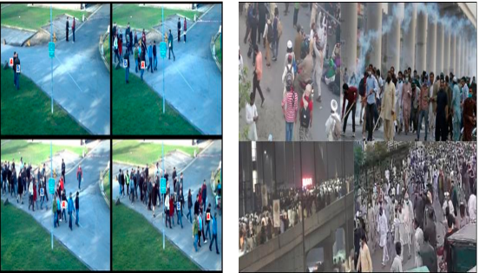
JHU Crowd++ Dataset Samples

Slide 9
Data Annotations
Computers require context and annotations to interpret visual information and make informed decisions.
Data annotation is crucial for linking visual content like images, text, videos, and audio to enable deep learning models to understand and generate predictions.
Supervised learning methods, like the one used in this work, rely on labeled data for model training.

Slide 10
Data Annotations
Utilized labelIng tool for data labeling.
Converted video clips into images at 1 frame per second for annotation.
Labeled violent individuals with weapons and peaceful crowds with placards or empty hands.
Semantic segmentation annotation for road detection to understand the protest environment.
Showcased an annotated image of a violent crowd using the labelImg tool in next slide

Slide 11
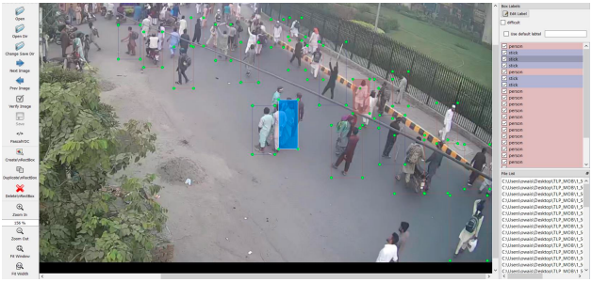
JHU Crowd++ Data Annotations Sample

Slide 12
Experimental Setup (Hardware Used)
NVIDIA GPU V100 96GB GPU (cluster) for training and testing.
System RAM: 128 GB.
Utilized high computational resources due to large dataset size and real-time processing requirements.

Slide 13
Experimental Setup (Software and Frameworks)
Operating System: Ubuntu 22.04.
Programming Language: Python 3.8.
Deep Learning Frameworks:
PyTorch 1.6.0 for efficientDet implementation.
Torchvision 0.10.0 for model training and evaluation.
TensorFlow 2.3.0 for additional functionalities and experimentation.

Slide 14
Experimental Setup (Experimental Environment)
Configured on Linux operating systems for compatibility and performance optimization.
The Python language was used for scripting and implementing the algorithms.
The combination of hardware and software ensured efficient training and testing of object detection and segmentation models.

Slide 15
Reference
[1] Adwan Alownie Alanazi and Muhammad Bilal. Crowd density estimation using novel feature descriptor. arXiv preprint arXiv:1905.05891, 2019.
[2] Chong Shang, Haizhou Ai, and Bo Bai. End-to-end crowd counting via joint learning local and global count. In 2016 IEEE International Conference on Image Processing (ICIP), pages 1215–1219. IEEE, 2016.
[3] A Alahi, V Ramanathan, K Goel, A Robicquet, AA Sadeghian, L Fei-Fei, and S Savarese. Group and crowd behavior for computer vision, 2017.
[4] Mahdyar Ravanbakhsh, Moin Nabi, Hossein Mousavi, Enver Sangineto, and Nicu Sebe. Plug-and-play cnn for crowd motion analysis: An application in abnormal event detection. In 2018 IEEE Winter Conference on Applications of Computer Vision (WACV), pages 1689–1698. IEEE, 2018.

